Slide 1



Machine Learning & Vision

Slide 2

Slides Plan
23 June
Machine Learning
R studio
27 June
Machine Vision
Google’s TensorFlow (Lite I’m not a monster)

Slide 3
23 June - Machine Learning
z
“A computer program is said to learn from experience E with respect to some class of tasks T and performance measure P, if its performance at tasks in T, as measured by P, improves with the experience E.”-Tom M. Mitchell

Slide 4

Acknowledgement of Country
z
I’d like to begin by acknowledging the Traditional Owners of the land on which we meet today. I would also like to pay my respects to Elders past and present.
Notes:
Image Sourced From https://mavink.com/explore/Acknowledgement-of-Country-Picture

Slide 5
Session Content
RStudio Overview
Data Cleaning & Analysis With Jordan 'F' Farrow
Infidelity Predictor 3000

Slide 6

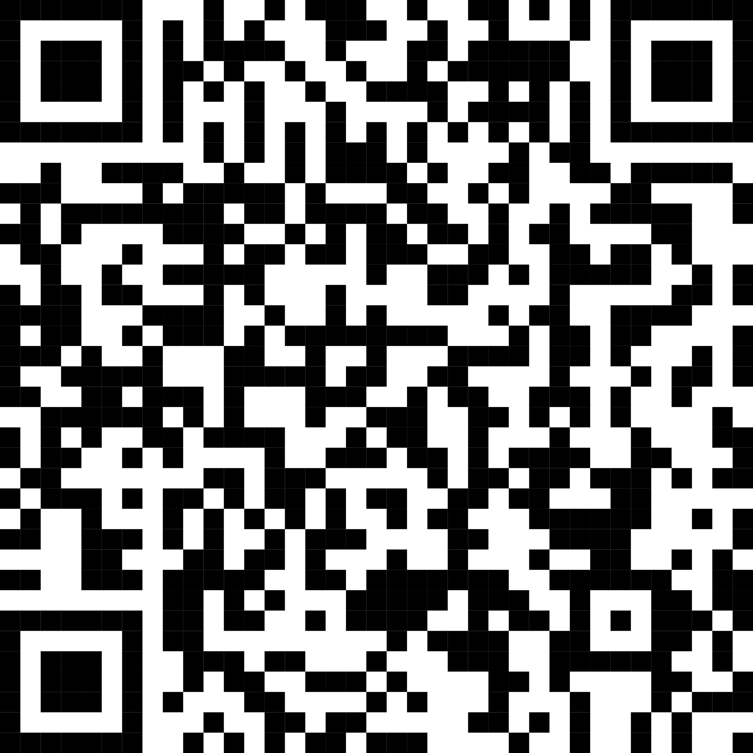
Where will Content Be?
https://github.com/HalcyonEcho/Workshops

Slide 7

RStudio Overview
“The Lebron James of R IDEs” - Unknown

Slide 8
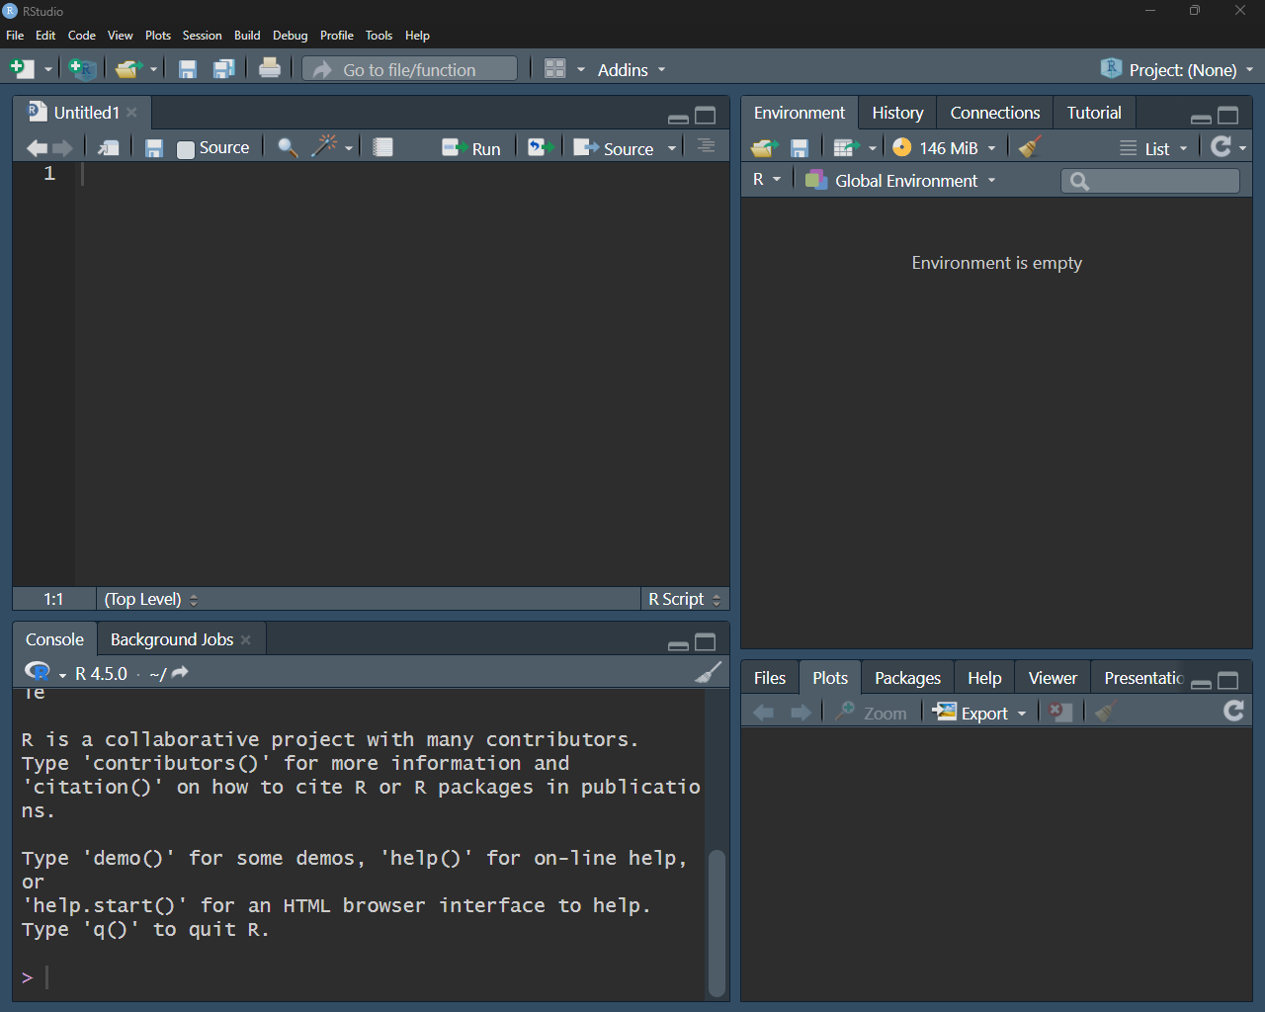
What is RStudio ?
An Integrated Development Environment (IDE) mainly for R and Python
Used Mainly in Data Science and Machine Learning.
Features code execution and plotting.

Slide 9

Installing ✨RStudio ✨
Using : https://posit.co/downloads/
Install RStudio
Remember to install R as well at https://cran.r-project.org/bin/windows/base/

Slide 10
R Studio Continued…
Code Editor
Variables, history
File Explorer, Plots, Packages, etc
R Console

Slide 11
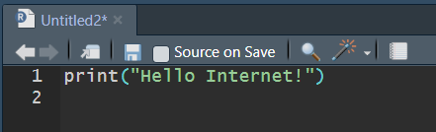
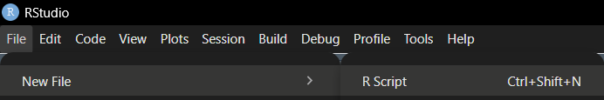
Creating a file

Slide 12
References
ML quote - Machine Learning, Tom Mitchell, McGraw Hill, 1997

Slide 13
Up Next…..
z

Slide 14


Data Cleaning & Analysis With Jordan 'F' Farrow
“I Love Cleaning!" - Ming Ren Milen

Slide 15

Data cleaning - Introduction
What is data cleaning?
The act of manipulating data sets to produce optimal results
Why perform data cleaning?
Deal with invalid values not meant to influence results
Prevent outliers from over influencing findings
"Rubbish in = Rubbish out"
Two types to be discussed:
Invalid data
Outliers

Slide 16
Data cleaning – Why is Cleaning So Hard?
It is very subjective!
The way one individual perceives a dataset may differ from another
May result in the same dataset producing different results...
This makes it all the more important!
Ensuring appropriate data is used could:
Save lives
Detect cyber attacks

Slide 17
Data cleaning – Invalid Data
Data outside the expected range(s) of a feature (default is NA in R)
Examples:
'99999 values indicating a timed-out ping'
'Below 0 values for the number of sheep owned'
'??? values for operating system used'
These values must be converted into NA
Rule of thumb:
>20% invalid, analyse why they are missing

Slide 18
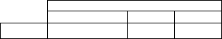



Activity: Deal with invalid non-NA data
Import the dataset into the R file.
1.2. (If you wish, view the file to spot where these invalid values are).
2. clean cyl, converting '????' Values into NA.
3. clean hp, converting negative values into NA.
4. clean drat, converting 99999 values into NA.

Slide 19

Data cleaning – Dealing With Invalid Data
There are 3 ways to deal with our now NA invalid data
1. Drop the entire feature
NOT RECOMMENDED!... sometimes (depends on the % missing)
By removing an entire feature, results become restricted to fewer factors, causing incorrect/biased predictions
Before removing a feature, consider looking at why many invalid values exist. Data gathering may be flawed from the beginning...
Example dropping feature vs within cars dataset:

Slide 20
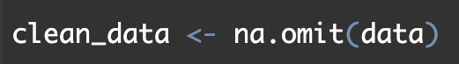
Data cleaning – Dealing With Invalid Data
There are 3 ways to deal with our now NA invalid data
2. Analyse complete cases only (all cells are valid entries)
Most common cleaning method you will probably use
Removes rows where cells have NA values
frame <- na.omit(frame)
Example using our cars dataset:

Slide 21
Data cleaning – Dealing With Invalid Data
There are 3 ways to deal with our now NA invalid data
3. Impute missing values
Replacing NA values with the features median
skews distribution of data towards the median value (manipulating model predictions).
This means it is an action which should be taken for dealing with small amounts of NA values.

Slide 22
Activity: How should we clean our dataset?
Within our dataset, we now have multiple NA values:
What invalid cleaning method should we now perform?
What makes it a better choice over the other invalid cleaning types?

Slide 23
Activity: How should we clean our dataset?
Answers
Analyse complete cases only
Not enough invalid values to consider removing entire features
Too many to perform imputations (small dataset, 100 invalid values)
Impossible to search for the source of invalid values (we did not collect the data)

Slide 24
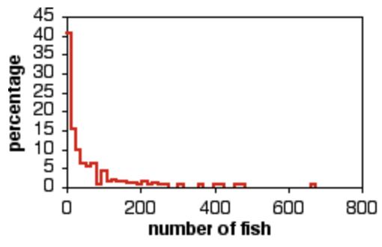
Data cleaning – Dealing With Outliers
Expected but larger/smaller values which heavily influence results
(makes interpreting results slightly easier as well!)
Example:
Number of fish within 75m areas
Outlier present at ~670 fish

Slide 25
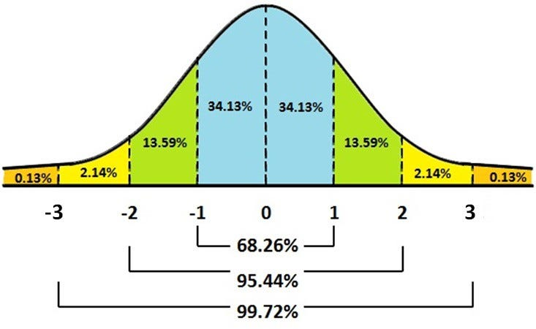
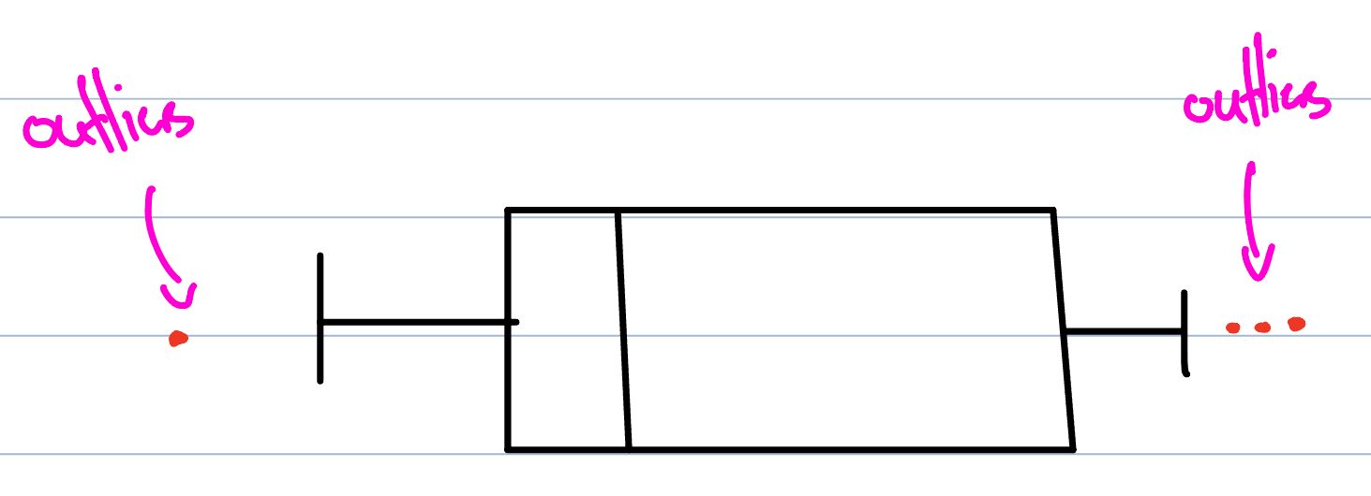
Data cleaning – Determining Outliers
Before we saw a histogram visualization to determine outliers
Other ways include:
1.5xIQR rule
+/- 3 z-scores

Slide 26

Data cleaning – Dealing With Outliers
There are 3 ways to deal with outliers
1. Remove the outliers
NOT RECOMMENDED!
These outliers are still valid data points
Removing these sways model predictions towards all other data points (small bias)

Slide 27

Data cleaning – Dealing With Outliers
There are 3 ways to deal with outliers
2. Investigate why outliers occurred
Only possible when you collected the dataset
In our case today, we didn't therefore not an option

Slide 28
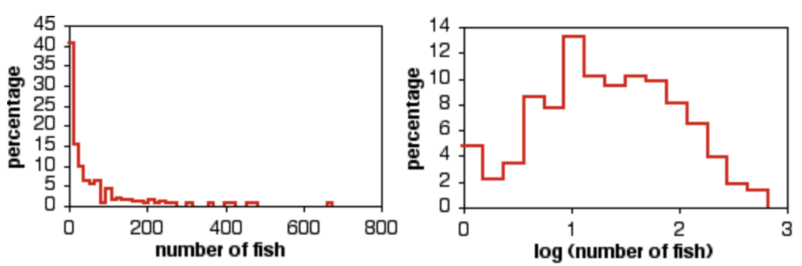
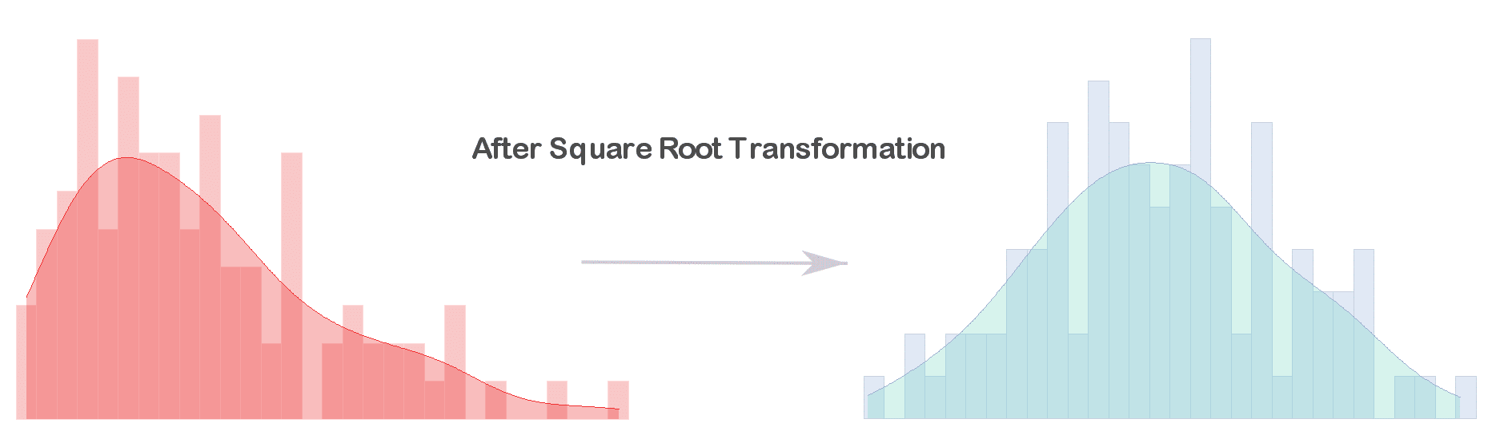
Data cleaning – Dealing With Outliers
There are 3 ways to deal with outliers
3. Perform square root or log transformations
Reduces the severity of outliers
Ensures further data points change model interpretations with less severity
Picking one over the other depends on how far you can reduce skewness

Slide 29
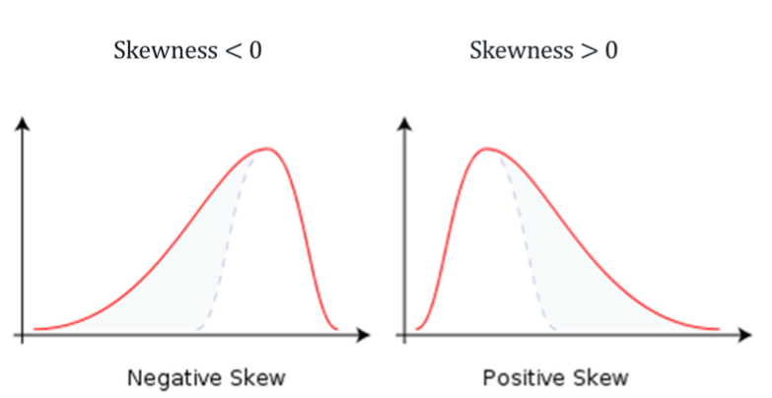
Data cleaning – Skewness & Outliers
Picking one over the other depends on how far you can reduce skewness
A skewness close to 0 is ideal!

Slide 30
Data cleaning – How do we decide cleaning type?
How data is cleaned is all about context!
By changing the interpretation of a dataset, its cleaning process changes
Let's discuss '99999' entries
'entries for average pings to a webserver'
Invalid as it is a timed-out ping
'average interest gained within a year'
Can be considered as outliers (higher than all other amounts, still a valid entry)
Reduces outlier severity whilst allowing it and all other values to contribute to the results
'average interest gained within accounts < 5000 dollars
Can be considered as invalid (no account with 5000 dollars is making $99,999 in interest)

Slide 31
References
https://www.biostathandbook.com/transformation.html
https://pub.towardsai.net/outlier-detection-and-treatment-9a9f41df0fb2
https://quantifyinghealth.com/square-root-transformation/

Slide 32
Up Next…..

Slide 33

Infidelity Predictor 3000
“A What?" – Tyler S

Slide 34
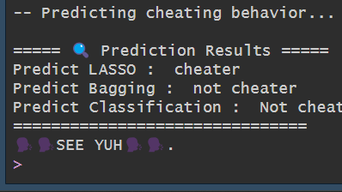
A What?
Its time to put Machine Learning to its place: Time to predict infidelity using a built-in data set!
In this mini-project we will be using 3 Machine Learning Models to train and predict your chance of an infidelity!
Firstly, We will go through the Theory of how it works, and ill hand out digital copies for instructions on how to make this predictor.

Slide 35

How??
In this project, we will be utilizing 3 Machine Learning Models, LASSO, Bagging Trees and Classification Trees.
Using these Models, we will first train them with a subsection of the model, followed by tuning them for use.

Slide 36
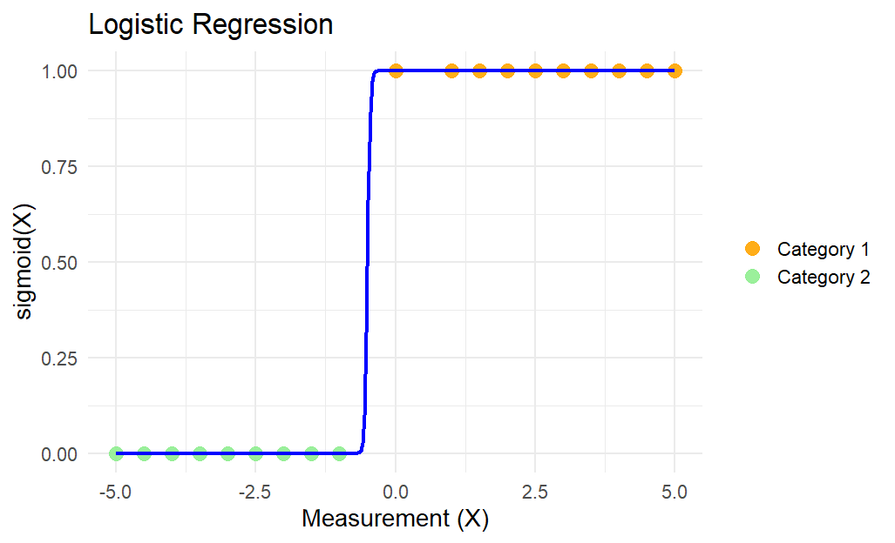
Logistic LASSO Regression – An overview.
This Model utilizes Logistic Regression - A form of modelling in which is strictly predicts a Binary Outcome based off 1 or more independent variables.
LASSO , or Least Absolute Shrinkage and Selection Operator, is a more regularized version of Logistic Regression, as it shrinks or drop variables entirely when predicting a binary answer based on how relevant they are to the prediction.
Perfect for reducing data noises
Common Uses : Credit Card Fraud, Telecom Fraud

Slide 37
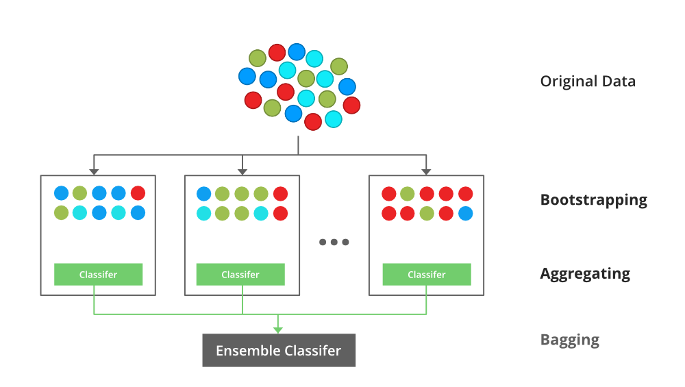
Bagging Trees– An overview.
Bagging = Bootstrap Aggregating
First, repeatedly draw Bootstrap Samples, or mini datasets, from the original sample,
Then, create multiple decision trees per bootstrap,
In our case, one boot strap may say (children is a key factor)
Finally, each bootstrap, in our context, will be aggregated to see which category is a key factor in prediction.
Good to prevent Overfitting (Model attempting to memorise instead of learning)
Used in Fraud Detection as well
Notes:
Image from https://www.geeksforgeeks.org/machine-learning/bagging-vs-boosting-in-machine-learning/

Slide 38


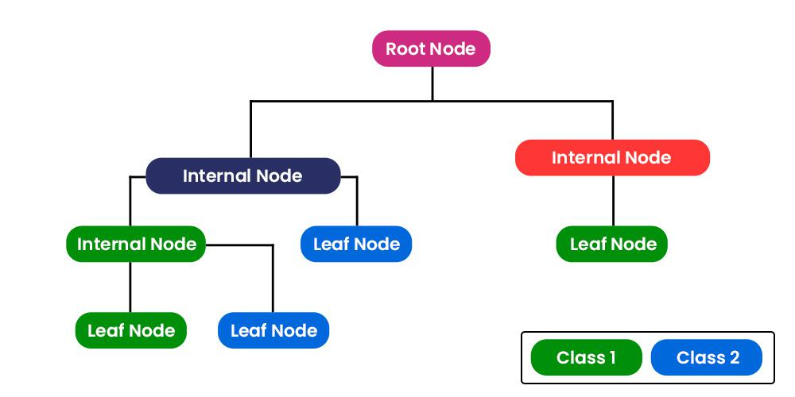

Classification Trees– An overview.
Also known as a CART (not carti), it’s a Classification And Regression Tree.
This Model Splits decisions based off categories until the final nodes, known as leaves.
The quirk about CART is that it cleans up by itself when it splits, ensuring that each node is sorted cleanly
Perk: Easily Explainable how it got its predictions
Uses: medical Diagnosis & credit scoring.
Notes:
Images from spotify and Geeks for geeks

Slide 39

Hyperparameter Tuning – An overview
Hyperparameter tuning is the process of finding the best combination of settings AKA hyper parameters to perfect how a model works.
Usually done manually or searched by the computer.
E.g. Grid Searching for a Bagging Tree hyperparameter values.

Slide 40
References
LASSO (Very Technical) - https://pmc.ncbi.nlm.nih.gov/articles/PMC5769953/#:~:text=much%20attention%20,LASSO%20is%20known
Bagging - https://bradleyboehmke.github.io/HOML/bagging.html
Classification – https://fderyckel.github.io/machinelearningwithr/trees-and-classification.html
Hyperparameter tuning - https://doi.org/10.48550/arXiv.2410.22854

Slide 41
Project Time
z
https://github.com/HalcyonEcho/Workshops

Slide 42

27 June - Machine Vision
Notes:
NETWK_O.POT

Slide 43
Overview
Test
Test
Test

Slide 44
References
Machine Vision - https://www.artspace.com/magazine/interviews_features/qa/qa-trevor-paglen-on-how-machine-made-images-are-asserting-power-over-society-54992

